Slide 1
Presentation on Air fare Prediction using ML
Author : Mr. Karne Mahesh

Slide 2
ABSTRACT
The "Flight Fare Prediction" project aims to develop an advanced predictive model leveraging machine learning algorithms to estimate and forecast airfare prices accurately. The unpredictable and dynamic nature of flight ticket pricing poses a significant challenge for travelers in planning and budgeting for their trips. This project seeks to alleviate this challenge by harnessing the power of machine learning to provide reliable and real-time predictions of flight fares. The project initiates by meticulously examining the myriad factors impacting flight fares, encompassing departure and arrival locations, booking timings, seasonal variations, airline preferences, and historical pricing trends. Through meticulous data collection and preprocessing, pertinent features are identified and subjected to a thorough analysis to discern their influence on ticket prices.

Slide 3
Problem Statement
Anyone who has booked a flight ticket knows how unexpectedly the prices vary. The cheapest available ticket on a given flight gets more & less expensive over time. This usually happens as an attempt to maximize revenue based on –
1. Time of purchase patterns (making sure last-minute purchases are expensive)
2. Keeping the flight as full as they want it (raising prices on a flight which is filling up in order to reduce sales and hold back inventory for those expensive last-minute expensive purchases)
So, you have to work on a project where you collect data of flight fares with other features and work to make a model to predict fares of flights.

Slide 4
LITERATURE REVIEW
Year | Project name | ML Technique | Performance (accuracy& speed) | Datasets | Limitations
2019 | Flight Fare Prediction | KNN, Linear Regression, SVM | Varied results; specifics not provided | Limited Delhi-Bombay flight dataset | Small dataset size; limited broader applicability.
2017 | Airfare Price Prediction | MLP, Regression NN, ELM, Bagging Tree | Optimal with Bagging; specifics not provided | 1814 Aegean Airlines records | Limited to one airline; generalizability issues.
2014 | Optimal Purchase Timing | Non-parametric Isotonic Regression | Insights gained; specifics not provided | Not specified | Assumes static pricing; requires extensive data
2013 | Optimizing Airline Ticket Purchasing | Partial Least Squares (PLS) Regression | Effective; specifics not provided | Not specified | May not reflect real-time market dynamics.

Slide 5
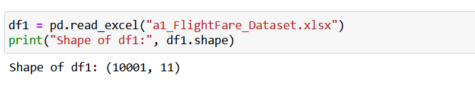
Dataset Information
Dataset contain flight detail of around 10001 Flights on route New Delhi to Mumbai. Dataset has 11 features like Airlines, flight, Aero plane etc.

Slide 6
Exploratory Data Analysis

Slide 7
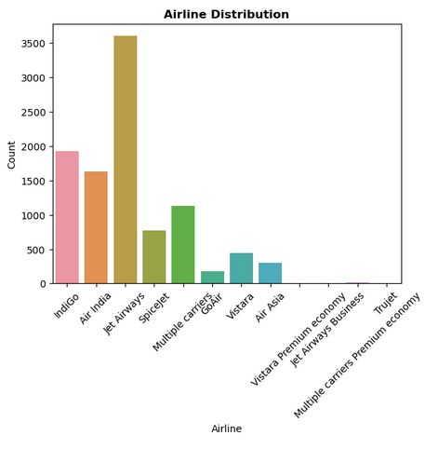
Flight-wise Distribution of Airlines
We can see maximum number of flights run by Spicejet while minimum Flights run by GoAir.
Around 25% of flights of Business Class.

Slide 8
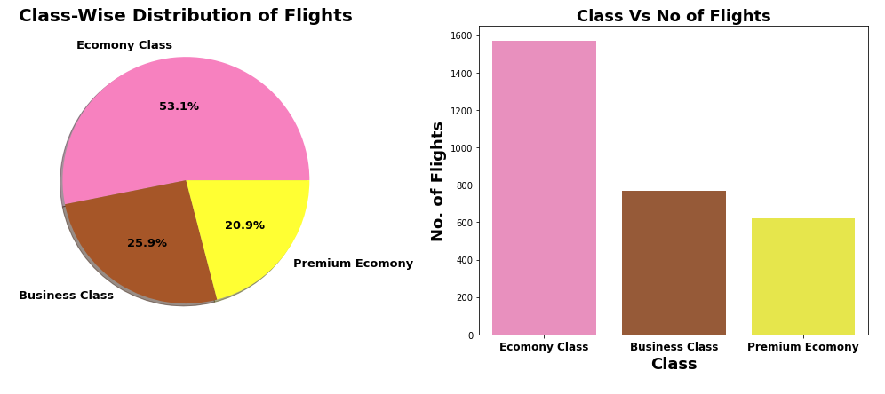
Class-wise Distribution of Flights
53.1% flights are of Economy class, as they are low cost of flight & most of people prefer it.
There are more business class flights than Premium Economy flights. It strange because Business class is costlier than Premium Economy class.

Slide 9
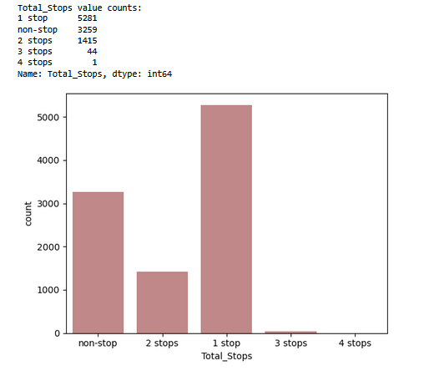
Stop-wise Distribution of Flights
52.9% flights take single stop in their way from New Delhi to Mumbai. It is also possible that these flights may have high flight duration compare to Non-stop Flight.
32.5% of flights do not have any stop in their route.

Slide 10
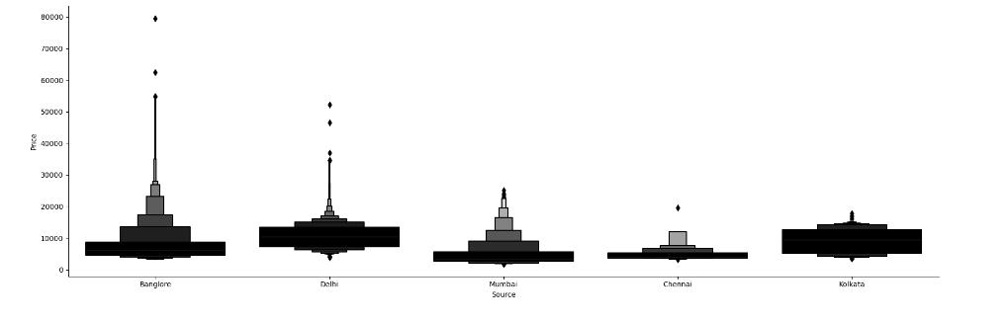
Source Vs Flight Price
Banglore has maximum price source
Chennai has minimum price source
Mumbai stands as average among all sources

Slide 11
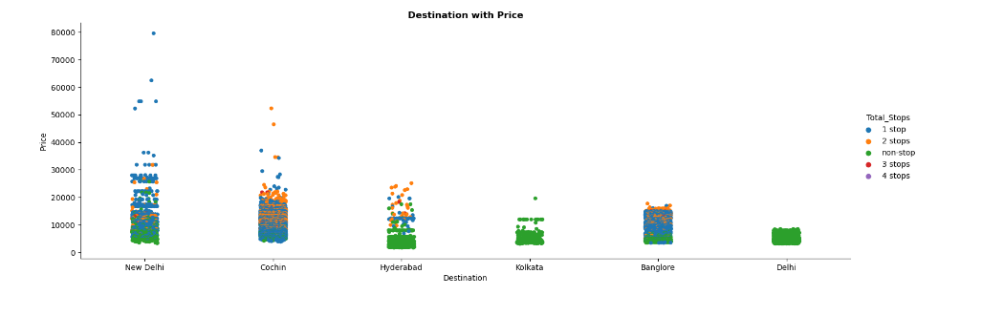
Destination Vs Flight Price
Single destination price is high from New Delhi
We mostly have single stop and non stop flights price are medium and high

Slide 12
MACHINE LEARNING MODEL BUILDING

Slide 13
Machine Learning Model Building
This problem can be solve using regression-based machine learning algorithm.
Methodology to Build Machine Learning Model:
Encoding Categorical data into Numerical data
Scaling data using Standard Scalar
Splitting data in training & test data using train_test_split from model_selection
Implementing various Regression Based Algorithm to build ML Model
Conducting 5 fold Cross validation
Hyper Parameter tuning of best Model
Saving Final Tuned Model using Joblib

Slide 14
REGRESSION ALGORITHMS IMPLEMENTATION
The different regression algorithm used in this project to build ML model are as below:
Linear Regression
Random Forest Regressor
Decision Tree Regressor
XGB Regressor
Extra Tree Regressor

Slide 15
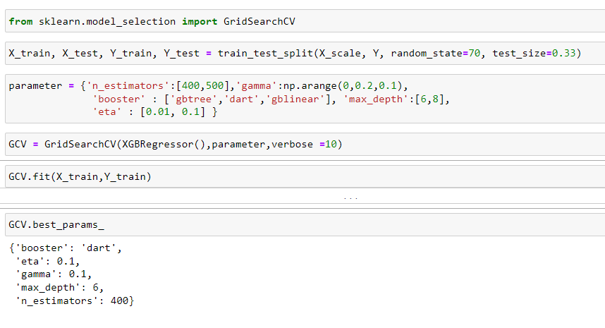
Hyper Parameter Tuning of Best Model
XGB Regressor gives maximum R2 score of 99.013 and maximum cross validation score.
Among all model we will select XGB Regressor as final model and hyper parameter tuning perform over this model to enhance its R2 Score.

Slide 16
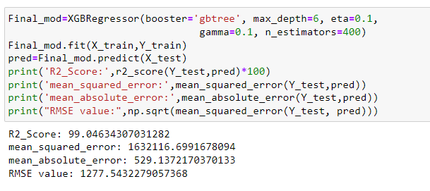
Final ML Hyper Parameter Tuned Model
There is Slight increase in R2-Score to 99.046% after hyper parameter tuning from previous R2-Score of 99.013%.

Slide 17
Final Evaluation Matrix
Algorithm | R2 Score | CV Score
Random Forest Regressor | 98.87 | 0.7976
XGB Regressor | 99.013 | 0.7582
Linear Regression | 73.32 | -16.392
Decision Tree Regressor | 98.50 | 0.6535
Extra Tree Regressor | 98.43 | 0.6631
XGB Hyper Parameter Tuned Final Model | 99.046 | 0.8283

Slide 18
Limitations & Future Scope
In this study we focus on flights on route of New Delhi to Mumbai, more route can incorporate in this project to extend it beyond present investigation.
This investigation focus on short timeframe (14 days prior flights take off) which can be extended variation over larger period.
Time series analysis can be performed over this model.

Slide 19
THANK YOU!!!

